Slide 1
Programming in C

Slide 2
Module 4:
Structures And Unions

Slide 3
Structures And Unions
Introduction, Declaring and defining Structure,
Structure Initialization,
Accessing and Displaying Structure Members,
Array of Structures,
Introduction to Unions,
Structure Vs Unions

Slide 4
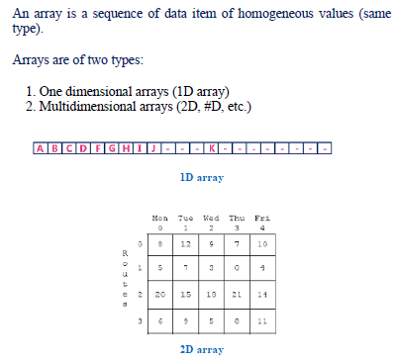
Arrays

Slide 5
Structures
Structure is a group of variables of different data types represented by a single name.
Syntax of struct
struct structureName
{
dataType member1;
dataType member2;
...
};
structureName is a structure tag and
book1 , book2, …are variables.

Slide 6
Structures
Variable declaration of a structure
struct structureName
{
dataType member1;
dataType member2;
...
};
int main()
{
struct struct_name var_name;
return 0;
}
OR
struct struct_name
{
DataType member1_name;
DataType member2_name;
DataType member3_name;
…
} var_name;

Slide 7
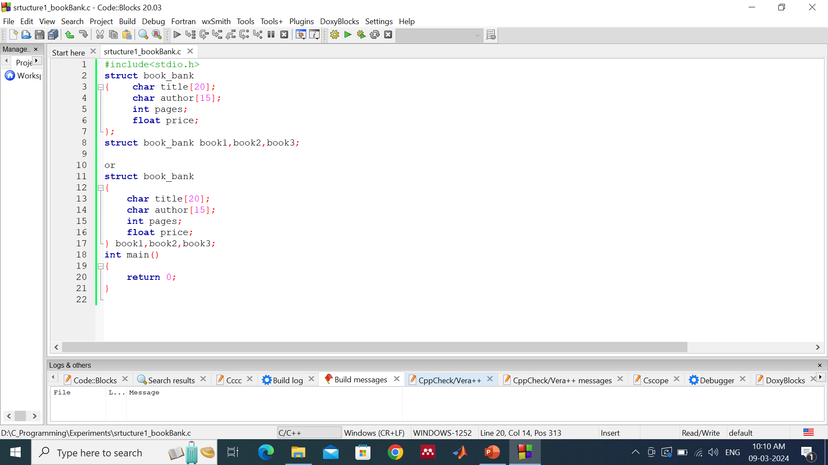
Variable declaration of a structure

Slide 8
Structures
Accessing members of a structure
var_name.member1_name;
var_name.member2_name;
…
Note:1. The members of the structure themselves are not variables.
2. They do not occupy any memory until they are associated with the structure variables such as book1…

Slide 9
Structures
Accessing members of a structure
var_name.member1_name;
var_name.member2_name;
…
Assign values to structure members
1) Using Dot(.) operator
var_name.memeber_name = value;
2) All members assigned in one statement
struct struct_name var_name =
{value for memeber1, value for memeber2 …so on for all the members}

Slide 10
Structures
Accessing members of a structure
var_name.member1_name;
var_name.member2_name;
…
Assign values to structure members
1) Using Dot(.) operator
var_name.memeber_name = value;
2) All members assigned in one statement
struct struct_name var_name =
{value for memeber1, value for memeber2 …so on for all the members}

Slide 11
e.g. book1.price;
book1.title=“Wings Of Fire”
Assign values using following ways:
strcpy(book1.title,”Wings of Fire”);
strcpy(book1.author,” A P J Abdul Kalam, Arun Tiwari”);
Book1.pages=250;book1.price=450.00;
Use of scanf:
scanf(”%s\n”,book1.title);
Scanf(”%d\n”,&book1.pages);

Slide 12
Structures
Task
WAP to display student name, roll number and CGPI using structures. (classwork)
WAP to display employee name, ID and year of experience. (homework)
Write separate code to Assign value at compile time and runtime
Rules for initializing structure variables at compile time:
1. cannot initialize individual members inside the structure template
2. The order of values enclosed in braces must match the order in the definition
3. partial initialization allowed.
4. Uninitialised members need to be at the end. Their default values are Zero for int and float type and ‘\0’ for char and strings.
…….Show structure1 and structure2_bookBank program …..

Slide 13
struct games_ticket
{
int value = 500;
/* ……initialization */
int seat_num = 52;
/*…… initialization */
int date, month, year;
}fan1;
Output ?
struct games_ticket /* structure tag */
{
int value;
int seat_num;
int date, month, year;
} fan1={500, 52};
Output ?

Slide 14
Structures
Array of Structures
Declaring an array of structure is same as declaring an array of fundamental types. Since an array is a collection of elements of the same type. In an array of structures, each element of an array is of the structure type.
Syntax
struct car
{
char make[20];
char model[30];
int year;
};
struct car arr_car[10];

Slide 15
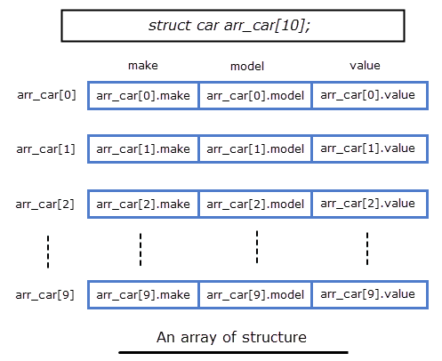
Structures
Array of Structures

Slide 16
Structures
Array of Structures
Task
WAP to display car name and number for 5 cars using array of structures
Define array size
Write for loop to accept as well as to display elements.

Slide 17
Structures
Array of Structures
Task
WAP to display car name and number for 5 cars using array of structures
Define array size
Write for loop to accept as well as to display elements.
for(i = 0; i < 5; i++ )
{
printf("%s\t%d\n", arr_car[i].name, arr_car[i].number);
}

Slide 18
Structures: structures within structures(nesting of structures)
struct salary
{
char name;
char dept;
int basic_pay;
int dearness_allowance;
int house_rent_allowance;
int city_allowance;
}employee;
// can use tag names to define inner structures
struct pay
{
int dearness;
int house_rent;
int city;
};
Struct salary
{ char name;
char dept;
struct pay allowance;
struct pay arrears;
};
Struct salary employee[100];
struct salary
{ char name;
char dept;
struct // no tag
{ int dearness;
int house_rent;
int city;
} allowance;
}employee;
Assessing inner-most member ...as follows:
Employee.allowance.dearness
Employee.allowance.house_rent

Slide 19
Structures: structures and functions
C supports the passing of structure values as arguments to functions.
The first method is to pass each member of the structure as an actual argument of the function call. Unmanageable and inefficient when structure size is large.
Passing a copy of the entire structure to the called function.. Hence any changes to structure members within a function are not reflected in the original structure(in the calling function). All compilers may not support this method.
Pointers to pass the structure as an argument. The address location of the structure is passed to the called function.

Slide 20
Structures: structures and functions
The general format of sending a copy of a structure to the called function is
Function_name(structure_variable_name);
The called function takes the following form:
data_type function_name(struct_type st_name)
{ …….
…….
return(expression);
}

Slide 21
Note:
1. The called function must be declared for its type, appropriate to the data type it is expected to return. e.g. if it is returning a copy of the entire structure, then it must be declared as struct with an appropriate tag name e.g
The structure variable used as an actual and formal argument (in called function) must be of the same type.
Return statement is necessary only when the function is returning some data to the calling function. The expression may be any simple variable or structure variable or an expression using simple variables.
When the function returns structure, it must be assigned to a structure of identical type in the calling function.
The called functions must be declared in the calling function appropriately.

Slide 22
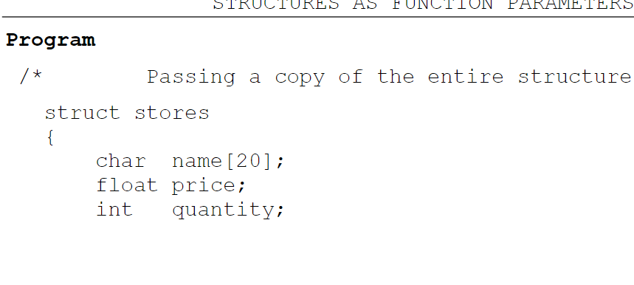
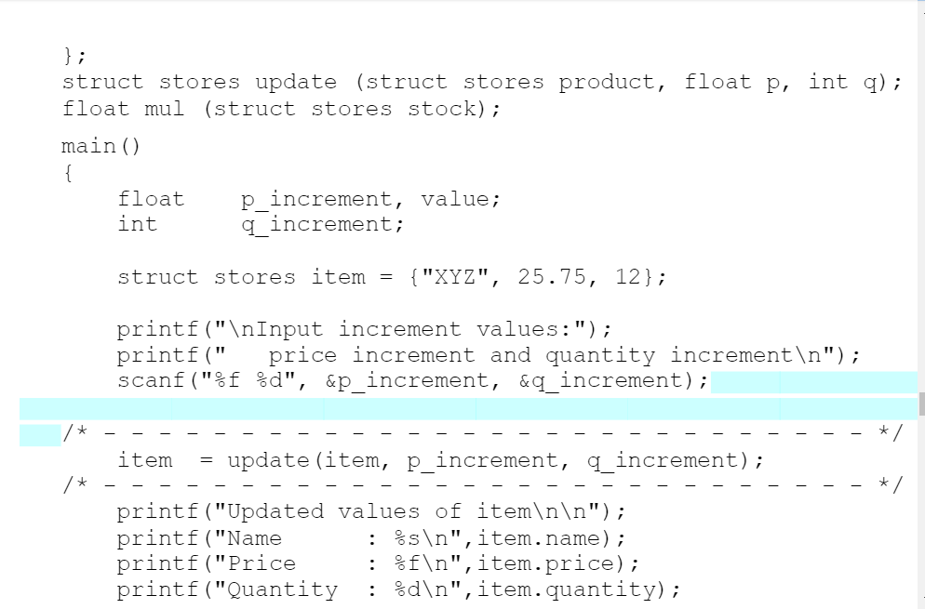

Slide 23
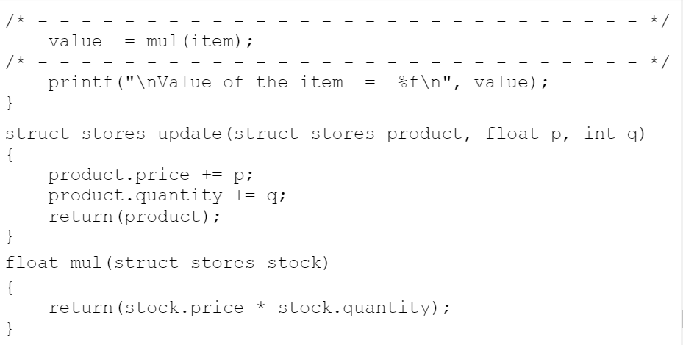
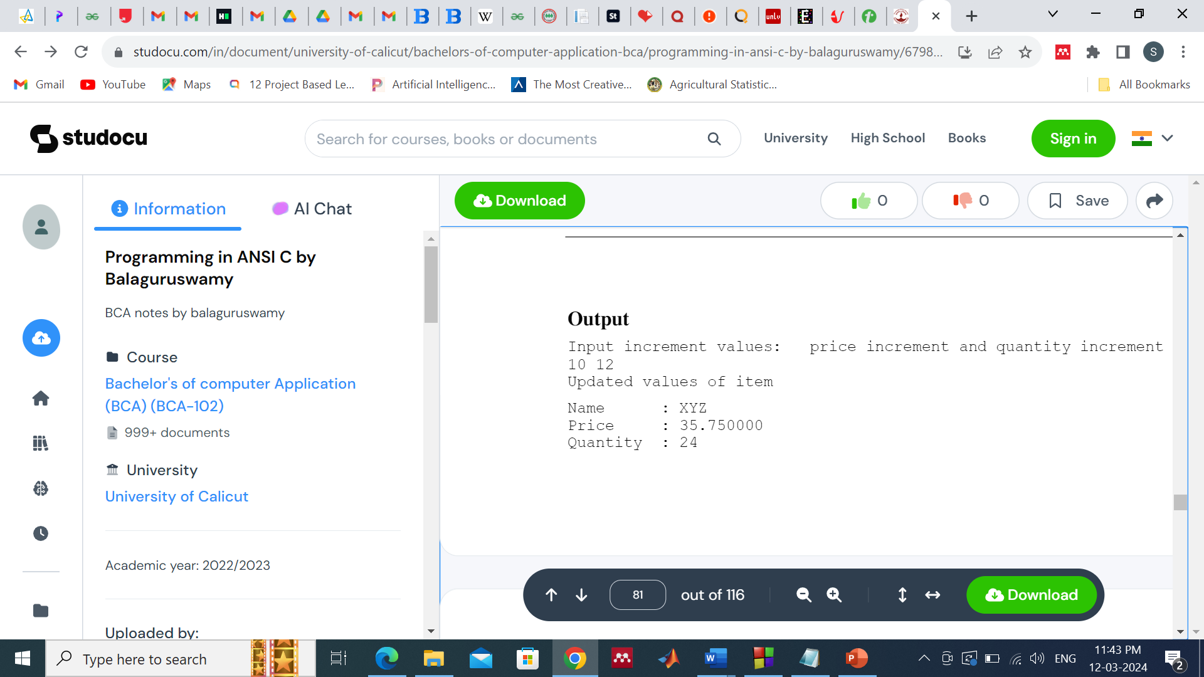

Slide 24
Unions
Unions
A union is a special data type available in C that allows to store different data types in the same memory location.
You can define a union with many members, but only one member can contain a value at any given time.
Unions provide an efficient way of using the same memory location for multiple-purpose.

Slide 25
Unions
Unions
union [union tag]
{
member definition;
member definition;
...
member definition;
} [one or more union variables];

Slide 26
Unions
Unions
union [union tag]
{
member definition;
member definition;
...
member definition;
} [one or more union variables];
union Data
{
int i;
float f;
char str[20];
} data;

Slide 27
union Data
{ int i;
float f;
char str[20];
} data;
Unions
Unions
Now, a variable of type Data can store an integer, a floating-point number, or a string of characters. It means a single variable, i.e., same memory location, can be used to store multiple types of data. You can use any built-in or user defined data types inside a union based on your requirement.
The memory occupied by a union will be large enough to hold the largest member of the union. For example, in the above example, Data type will occupy 20 bytes of memory space because this is the maximum space which can be occupied by a character string.

Slide 28
Unions
#include <stdio.h>
#include <string.h>
union Data {
int i;
float f;
char str[20];
};
int main( )
{
union Data data;
data.i = 10;
data.f = 220.5;
strcpy( data.str, "C Programming");
printf( "data.i : %d\n", data.i);
printf( "data.f : %f\n", data.f);
printf( "data.str : %s\n", data.str);
return 0;
}

Slide 29
Unions
#include <stdio.h>
#include <string.h>
union Data {
int i;
float f;
char str[20];
};
int main( )
{
union Data data;
data.i = 10;
data.f = 220.5;
strcpy( data.str, "C Programming");
printf( "data.i : %d\n", data.i);
printf( "data.f : %f\n", data.f);
printf( "data.str : %s\n", data.str);
return 0;
}
Here, we can see that the values of i and f members of union got corrupted
because
the final value assigned to the variable has occupied the memory location
and
this is the reason that the value of str member is getting printed very well.

Slide 30
Unions
#include <stdio.h>
#include <string.h>
union Data {
int i;
float f;
char str[20];
};
int main( ) {
union Data data;
data.i = 10;
printf( "data.i : %d\n", data.i);
data.f = 220.5;
printf( "data.f : %f\n", data.f);
strcpy( data.str, "C Programming");
printf( "data.str : %s\n", data.str);
return 0;
}
Here, all the members are getting printed very well
because
one member is being used at a time.

Slide 31
Union : Unions can also be a member of a structure. The following is an example showing such a structure.
struct conditions
{
float temp;
union feels_like
{
float wind_chill;
float heat_index;
}
} today;
As is known, wind_chill is only calculated when it is ‘cold’ and heat_index when it is ‘hot’. There is no need for both at the same time.
So when the today is specified, feels_like has only one value, either a float for wind_chill or a float for heat_index.
Within a union, data types can be of any kind; in fact, it may even be of struct type.

Slide 32
#include <stdio.h>
#include <stdlib.h>
#include <string.h>
struct S
{
int i;
char ch;
double d;
};
union U
{
int i;
char ch;
double d;
}
int main()
{
printf(“\n Size of the structure is %d”, sizeof (struct S));
printf(“\n Size of the union is %d”, sizeof(union U));
return 0;
}

Slide 33
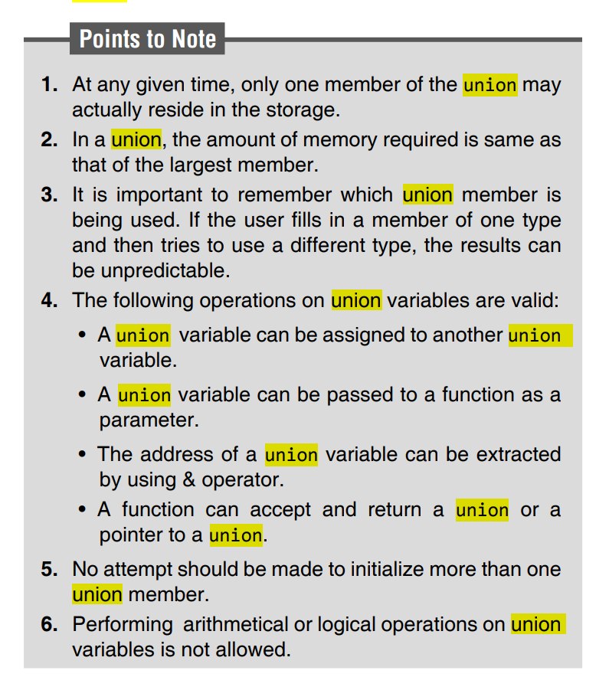

Slide 34
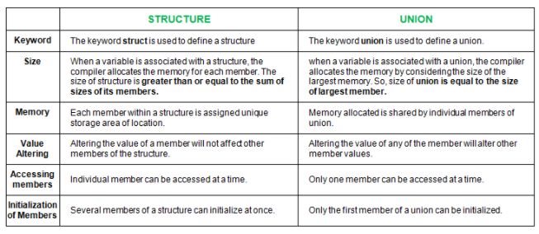
Structures And Unions
Structures Vs Unions

Slide 35
ENUMERATION TYPES
Enumeration data types are data items whose values may be any member of a symbolically declared set of values. The symbolically declared members are integer constants.
The keyword enum is used to declare an enumeration type. The general construct used to declare an enumeration type is
enum tag_name{member1, member2,…, memberN} variable1,...,variableX;
The enum tag_name specifies the user-defined type. The members are integer constants. By default, the first member, that is, member1, is given the value 0. The second member, member2, is given the value 1.

Slide 36
The general form of the construct for declaring variables of enum type separately is
enum tag_name variable1,...,variableX;
The variables can take on as values only the members in the member list.
Therefore, variable1 = member2;
assigns the value represented by member2 to variable1. A typical declaration would be
enum days {Mon, Tues, Wed, Thurs, Fri, Sat, Sun};
#include <stdio.h>
enum days{Mon, Tues, Wed, Thurs, Fri, Sat, Sun };
int main()
{
enum days start, end;
start= Tues; /* means start=1 */
end= Sat; /* means end=5 */
printf(“\n start = %d, end = %d”, start,end);
start= 64;
printf(“\n start now is equal to %d”, start); return 0; }
Output: start = 1, end = 5 start now is equal to 64

Slide 37
It is possible to associate numbers other than the sequence starting at zero with the names in the enum data type by including a specific initialization in the variable name list.
enum coins{ p1=1, p2, p5=5, p10=10, p20=20, p50=50 };
Here all the variables except p2 are initialized. Since p2 is next to p1, it will be assigned a value 2.
Different Cases:
enum fruit {mango=10, orange, apple=6, pear}fru;
enum veg{tomato=15, beans=15, onions=15} veget1,veget2;
enum {teak,pine}tree;
In this case, since no tag name has been specifi ed, no other variable of type enum {teak,pine} can be declared.
enum veg{tomato,beans,onions}veg;

Slide 38
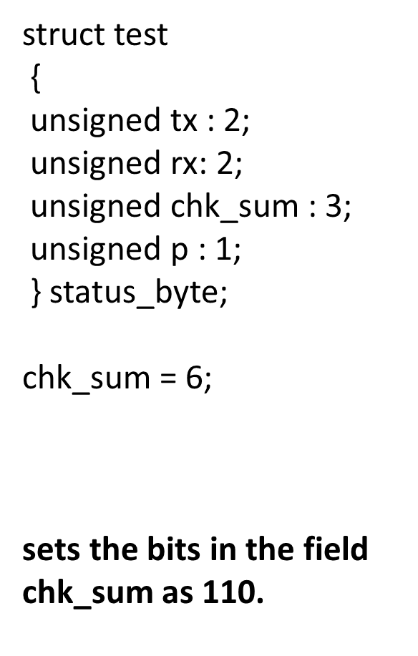
BITFIELDS
There are two ways to manipulate bits in C. One of the ways consists of using bitwise operators. The other way consists of using bitfields in which the definition and the
access method are based on structure. The general format for declaring bitfields using a structure is given as follows.
struct bitfield_tag
{
unsigned int member1: bit_width1;
unsigned int member2: bit_width2;
.
.
.
unsigned int memberN: bit_widthN;
}; struct bitfield_tag variable_name;

Slide 39
#include <stdio.h>
#include <stdlib.h>
struct cbits {
unsigned b1 : 1;
unsigned b2 : 1;
unsigned b3 : 1;
unsigned b4 : 1;
unsigned b5 : 1;
unsigned b6 : 1;
unsigned b7 : 1;
unsigned b8 : 1;
};
union U {
char c;
struct cbits cb;
};
int main()
{
union U look;
/* Assign a character to memory */
look.c = ‘A’;
/* Look at each bit */
printf( “\nBIT 1 = %d\n”, look.cb.b1 );
printf( “BIT 2 = %d\n”, look.cb.b2 );
printf( “BIT 3 = %d\n”, look.cb.b3 );
printf( “BIT 4 = %d\n”, look.cb.b4 );
printf( “BIT 5 = %d\n”, look.cb.b5 );
printf( “BIT 6 = %d\n”, look.cb.b6 );
printf( “BIT 7 = %d\n”, look.cb.b7 );
printf( “BIT 8 = %d\n\n”, look.cb.b8 );
return 0;
}
Output :
BIT 1 = 0 BIT 2 = 1 BIT 3 = 0 BIT 4 = 0
BIT 5 = 0 BIT 6 = 0 BIT 7 = 0 BIT 8 = 1
The output makes sense because 01000001 (binary) = 65 (decimal) = 101 (octal) = 41 (hexadecimal) which
maps to an A in the ASCII character set.

